Slide 1


CSE 455 Software Testing
Lecture 4
This course is offered to the students of students of BS Software Engineering who are enrolled in 8th semester

Slide 2
Course instructor Yella mehroze
yellamehroze@cuilahore.edu.pk

Slide 3
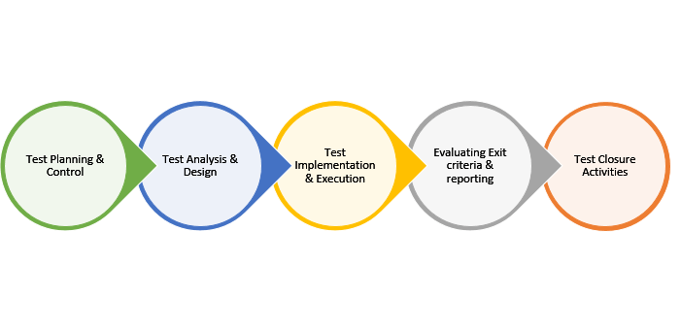
Software testing process
Notes:
NOTE:
To change the image on this slide, select the picture and delete it. Then click the Pictures icon in the placeholder to insert your own image.

Slide 4
Outline
Basic Definitions
Fundamental of test processes
Requirement Traceability Matrix

Slide 5
Basic Definitions
Test basis
It is the information or the document that we need to create our own test cases and start the test analysis.
Test analysis
It is the process of looking at something that can be used to derive test information.
Test Condition
An item or event of a component or system that could be verified by one or more test cases, e.g., a function, transaction, feature, quality attribute, or structural element.

Slide 6
Basic Definitions
Test Procedure Specification
A document specifying a sequence of actions for the execution of a test. Also known as manual test script.
Test Script
Commonly used to refer to a test procedure specification, especially an automated one.
Test Suites
Are collection of test cases that are used to test a software program to show that it has some specified set of behaviors

Slide 7
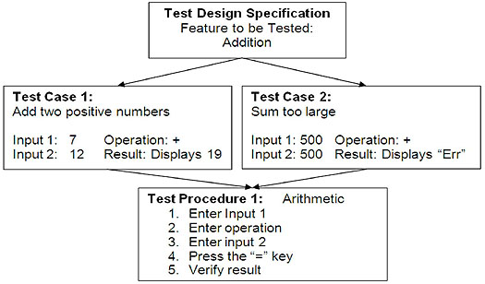
Basic Definitions

Slide 8
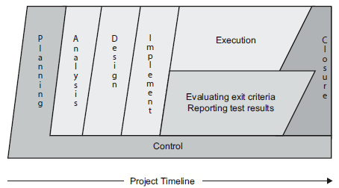
Software Testing Process

Slide 9
Fundamental of Test Processes
Test Planning and Control
Test Analysis and Design
Test implementation and execution
Evaluating exit criteria and Reporting
Test closure activities

Slide 10
1. Test Planning and Control
Test plan:
A document describing the scope, approach, resources and schedule of intended test activities.
It consists of the following:
The scope, risk and objective of testing
The test policy and/or the test strategy
List of the features to be tested
Details of the testing tasks
Who will do each task (Resource Allocation)
The test environment
The test design techniques
Entry and exit criteria to be used
Test Schedule
Any risks requiring contingency planning

Slide 11
1. Test Planning and Control
Test Planning
The activity of establishing or updating a test plan.
Continuous process and performed in all project life cycles
Test control has the following major tasks:
To measure and analyze the results of reviews and testing
To monitor and document progress, test coverage and exit criteria
To provide overall information on testing
To initiate corrective actions
To make decisions

Slide 12
2. Test Analysis and Design
The test objectives are a major deliverable for technical test analysts to know what to test.
We use test objectives as our guide to
Identify and refine the test conditions for each test objective
Create test cases that exercise the identified test conditions
We need to prioritize the test conditions on the basis of likelihood and impact associated with each quality risk item as we know that testing everything is an impractical goal.
Following steps are followed for analysis and design phase:
Non-functional Test Objectives
Identifying and Documenting Test Conditions
Test Oracles
Standards

Slide 13
2.1 Non-functional Test Objectives
Non-functional test objectives can apply to any test level and exist throughout the lifecycle
Major non-functional test objectives are addressed at the end of the project
If test execution is not possible to start at any level, reviews of requirements, design and code can be conducted
Performance testing should be performed as early as possible
Performance testing should be done at unit and component level and also at the time of integration

Slide 14
2.2 Identifying and Documenting Test Conditions
Identify functional and non-functional test conditions
Two important choices while Identifying and Documenting Test Conditions are:
The structure of the documentation for the test conditions
Work in parallel with the test basis documents.
Generate the high-level test conditions
Elaborate into one or more low-level test conditions underneath each high-level test condition

Slide 15
2.2 Identifying and Documenting Test Conditions
The level of detail we need to describe the test conditions in the documentation
Outline the key features and quality characteristics at a high level.
Identify one or more detailed quality risk items for each feature or characteristic
If you have detailed requirements, go directly to the low-level requirements.
Traceability from the detailed test conditions to the requirements is ensured
Another approach is to identify high-level test conditions only
Chosen level of detail and the structure must align with the test strategy or strategies, and those strategies should align with the test plan or plans

Slide 16
2.2 Identifying and Documenting Test Conditions
The next step is to elaborate test conditions into test cases.
High-level test case
A test case without concrete (implementation-level) values for input data and expected results
These include test cases for
Functional testing
System Testing
Acceptance Testing
Low-level test case
A test case with concrete (implementation-level) values for input data and expected results.
These include test cases for
Unit testing
Integration testing

Slide 17
2.2 Identifying and Documenting Test Conditions
Test Design is basically the act of creating and writing test suites for testing a software.
Test analysis and identifying test conditions gives us a generic idea for testing which covers quite a large range of possibilities

Slide 18
2.2 Identifying and Documenting Test Conditions
Test Design Techniques
Static Techniques/Testing
Static testing is software testing technique where testing is carried out without executing the code.
This type of testing comes under Verification.
Dynamic Techniques/Testing
Dynamic testing is software testing technique where testing is carried out with executing the code.
This type of testing comes under Validation.

Slide 19
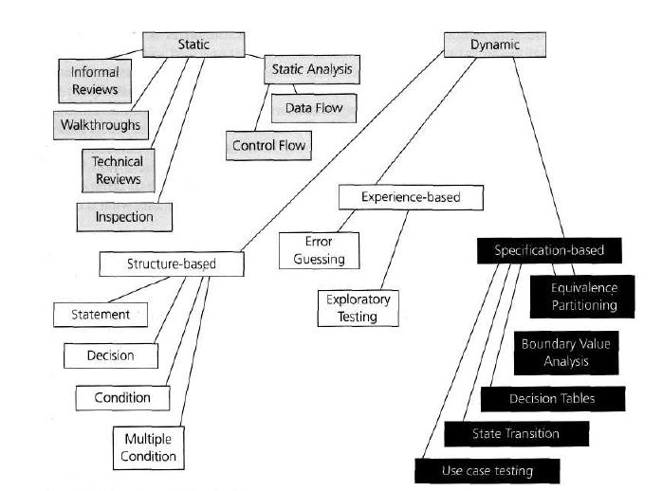
2.2 Identifying and Documenting Test Conditions
Notes:
Informal Reviews: An informal review aims to improve the quality of the tested product through discussions and is usually not documented. In start two to three tea members involved.
Walkthroughs: Walk through is not a formal process of review and is carried out by authors.
Technical Reviews: A technical review is carried out by a trained moderator or technical expert. It is less formal as compared to an inspection.
Inspection: An inspection is the most formal type of review and is conducted by trained moderators.
Control Flow: The control flow structure refers to the sequence of execution of instructions.
Data Flow: Understanding the fate of each data item as it is accessed and modified by the code.
Specification Based (Black Box):
Structure Based (White Box):
Exploratory Testing: This method, generally conducted by business analysts and experts, is followed to test the applications without any documentation.
Error guessing: is a testing technique that makes use of a tester's skill, intuition and experience in testing similar applications to identify defects that may not be easy to capture by the more formal techniques.

Slide 20
2.3 Test Oracles
A test oracle is a source we use to determine the expected results of a test
Oracle can be
Existing system
User manual
Individual’s specialized knowledge
Never use the code itself as an oracle because that’s simply testing that the compiler, operating system, and hardware work
Higher test levels like user acceptance test and system test rely more on requirements specification, use cases, and defined business processes.
Lower test levels like component test and integration test rely more on low-level design specification

Slide 21
2.4 Standards
The test design specification template includes
Test design specification identifier (following whatever standard your company uses for document identification)
Features to be tested (in this test suite)
Approach refinements (specific techniques, tools, etc.)
Test identification (tracing to test cases in suites)
Feature pass/fail criteria (e.g., how we intend to determine whether a feature works, such as via a test oracle, a test basis document, or a legacy system)

Slide 22
2.4 Standards
The test case specification template includes
Test case specification identifier
Test items (what is to be delivered and tested)
Input spécifications (user inputs, files, etc.)
Output specifications (expected results, including screens, files, timing, behaviors of various sorts, etc.)
Environmental needs (hardware, software, people, props (Other supporting things), and so forth)
Special procedural requirements (operator intervention, permissions, etc.)
Inter-case dependencies (if needed to set up preconditions)

Slide 23
3. Test Implementation and Execution
Test implementation has following task:
Develop and prioritize the test cases by using techniques and create test data for those tests.
Write test procedures.
Create test suites from the test cases for efficient test execution.
Implement and verify the environment.
Schedule test execution

Slide 24
3. Test Implementation and Execution
Test execution has the following major task:
To check test environments
To check traceability between test basis and test cases
To execute test suites and individual test cases following the test procedures using execution tools.
To re-execute the tests that previously failed in order to confirm a fix. This is known as confirmation testing or re-testing.
To log the outcome of the test execution and record the identities and versions of the software under tests. The test log is used for the audit trial..
To Compare actual results with expected results.
Where there are differences between actual and expected results, it report discrepancies as Incidents.

Slide 25
4. Evaluating exit criteria and Reporting
Evaluating exit criteria is a process defining when to stop testing.
The criteria vary from project to project.
Evaluating exit criteria has the following major tasks:
To check the test logs against the exit criteria specified in test planning.
To assess if more tests are needed or if the exit criteria specified should be changed
To write a test summary report for the stakeholders

Slide 26
4. Evaluating exit criteria and Reporting
We can measure properties of the test execution process such as the following:
Number of test conditions, cases, or test procedures that are planned, executed, passed, and failed
Total defects, classified by severity, priority, status, or some other factor
Change requests proposed, accepted, and tested
Planned versus actual costs, schedule, effort
Quality risks, both mitigated and residual
Lost test time due to blocking events
Confirmation and regression test results

Slide 27
5. Test Closure Activities
Test closure activities are done when the software is delivered
This process collects data from completed test process and test wares.
The testing can be closed for the other reasons like:
When all the information has been gathered which are needed for the testing.
When a project is cancelled.
When some target is achieved.
When a maintenance release or update is done.
Notes:
Testware: Used to describe all of the materials used to perform a test.

Slide 28
5. Test Closure Activities
It has following major tasks.
Ensure deliverable has been delivered or not
Ensure closing incident report
Documenting all the systems
Archiving all the test ware, test environment and infrastructure for later reuse.
Handover the testware to the maintenance organization. They will give support to the software.
To evaluate how the testing went and learn lessons for future releases and projects.

